Slide 1
AI Car with Real-time Detection of Damaged Road and Lane Detection

Slide 2
Abstract
This project develops an AI-powered Road and Lane Detection System for autonomous vehicles, utilizing YOLOv8 for road damage detection and Canny Edge Detection for lane marking identification. The system ensures real-time, accurate detection of road conditions and lane positioning, enhancing safety and efficiency on roadways. By leveraging machine learning and computer vision, it contributes to safer autonomous vehicle navigation in dynamic environments.

Slide 3
Introduction
Autonomous vehicles rely heavily on advanced computer vision systems to ensure safe and efficient navigation. One of the key challenges in this domain is the real-time detection of road conditions and lane markings, which are critical for safe driving. This project focuses on developing an AI-powered Road and Lane Detection System that uses YOLOv8 for road damage detection and Canny Edge Detection for identifying lane markings.
The system aims to provide autonomous vehicles with accurate and timely information about road conditions and lane positions, ensuring safer and more reliable transportation. By utilizing state-of-the-art machine learning and computer vision techniques, this project seeks to improve the overall capabilities of autonomous driving systems.

Slide 4
Existing System
Existing systems for road and lane detection rely on traditional computer vision techniques like edge detection and Hough transforms, which struggle with challenges like poor weather and unclear road markings. Deep learning-based approaches, such as YOLO, have improved accuracy and robustness for detecting road damage and lane markings in real-time.
However, current systems often focus on either road damage or lane detection in isolation, lacking integration for comprehensive vehicle navigation. This project combines YOLOv8 for road damage detection and Canny Edge Detection for lane marking identification, addressing these limitations. The goal is to provide a more reliable and efficient system for autonomous vehicle navigation.

Slide 5
Proposed System
The proposed system integrates advanced machine learning and computer vision techniques to improve road and lane detection for autonomous vehicles. Using YOLOv8, the system detects road damage in real-time, allowing the vehicle to identify and avoid obstacles. For lane detection, Canny Edge Detection is employed to accurately track lane markings, ensuring precise vehicle positioning within designated lanes.
The system is designed to function effectively in varying road conditions, including poor visibility and road surface damage. By combining these technologies, the proposed solution offers enhanced safety, reliability, and efficiency for self-driving vehicles, contributing to better roadway management and navigation.

Slide 6
LITERATURE REVIEW
Recent advancements in road and lane detection for autonomous vehicles have primarily focused on machine learning and computer vision techniques.
Traditional methods like Canny edge detection and Hough Transform were initially used for lane detection but struggled in noisy or complex environments. With the emergence of deep learning, algorithms like YOLO (You Only Look Once) have improved detection accuracy, allowing real-time identification of road damage and lane markings.
Datasets created with tools like Roboflow have been key to training more effective models. Combining YOLO with traditional techniques like edge detection offers a promising solution to enhance autonomous vehicle safety and navigation.

Slide 7
Module
YOLO (You Only Look Once)
Canny Edge Detection
Roboflow
OpenCV (Open Source Computer Vision Library)
NumPy
Matplotlib
PyTorch

Slide 8
YOLO (You Only Look Once): For real-time object detection and classification. The YOLO model is used for both road damage detection and lane marking identification.
Canny Edge Detection: A popular edge detection technique used to detect lane boundaries and road features by identifying abrupt changes in intensity.
Roboflow: A tool for creating custom datasets, used here to build a dataset for road damage and lane detection tasks.
OpenCV (Open Source Computer Vision Library): Used for image manipulation, video processing, and applying image processing techniques such as Canny edge detection.

Slide 9
NumPy: For handling and manipulating large arrays and matrices of image data during processing and computation.
Matplotlib: Used for visualizing the detected lanes and road damage on images
PyTorch: Framework for implementing the YOLO model and training it for real-time detection tasks.

Slide 10
Software Components:
YOLO (You Only Look Once)
OpenCV
Roboflow
PyTorch
Matplotlib
NumPy
Hydra
Hardware Components:
Camera/Camera Module
GPU (Graphics Processing Unit)
CPU (Central Processing Unit)
RAM (Random Access Memory)
Storage
Edge Device (Optional)
Power Supply

Slide 11
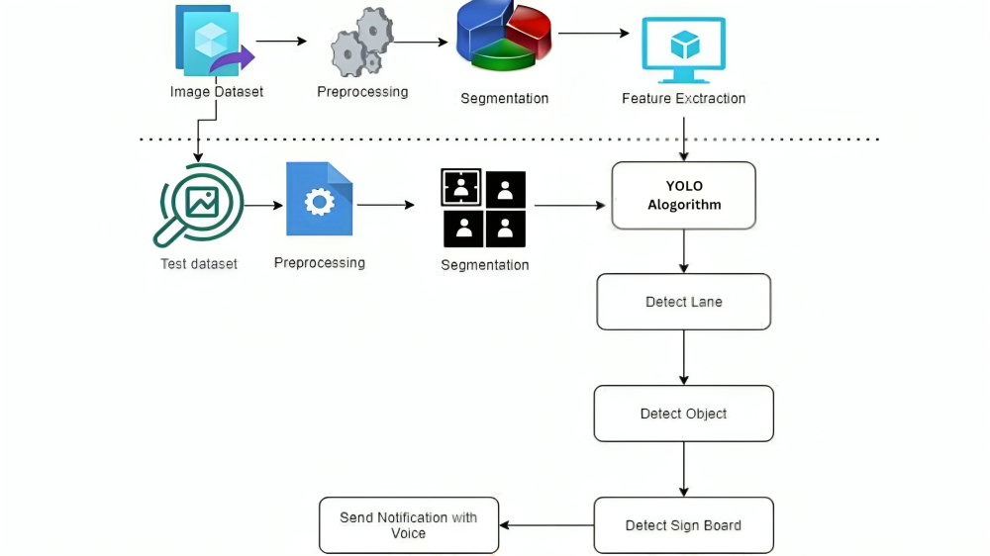
Block Diagram

Slide 12
UML Diagrams
Use Case Diagram
Data Flow Diagram
Sequence Diagram
State Diagram

Slide 13
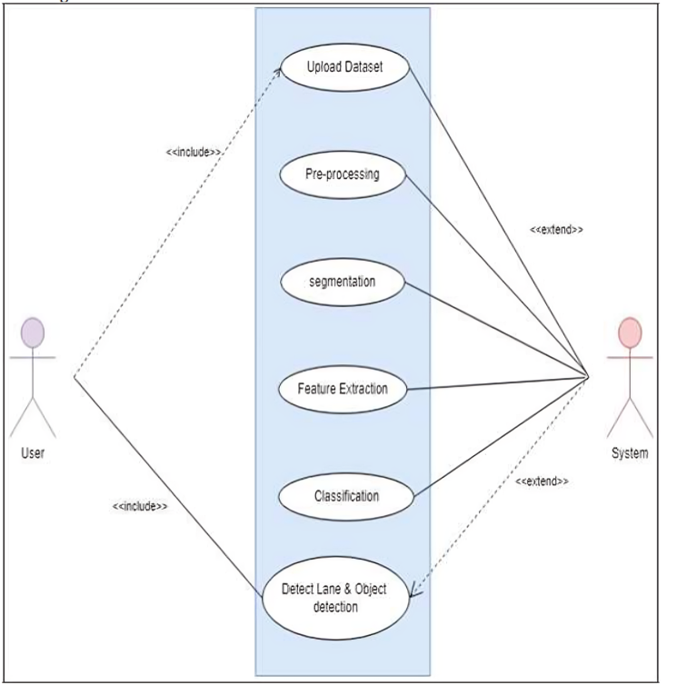
Usecase Diagrams

Slide 14
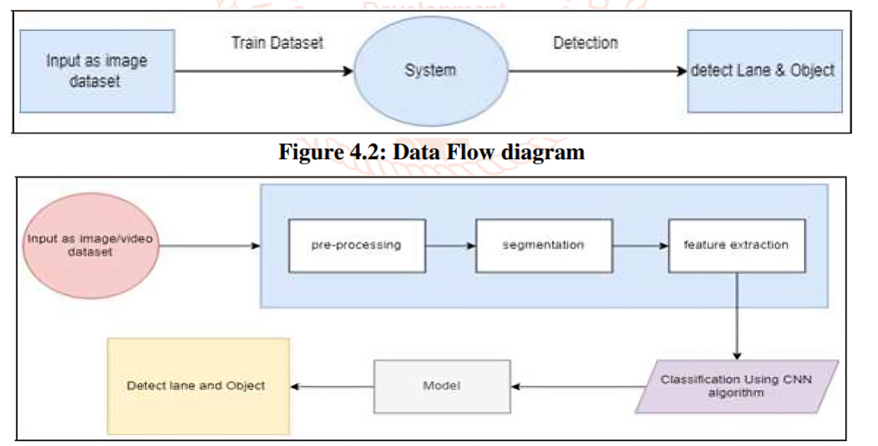
Data Flow Diagrams

Slide 15
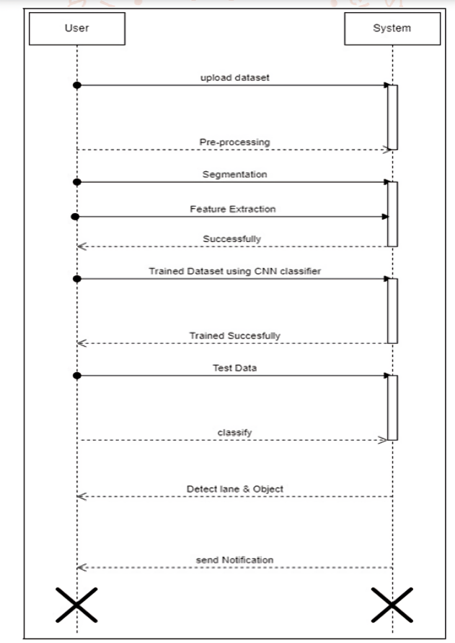
Sequance Diagrams

Slide 16
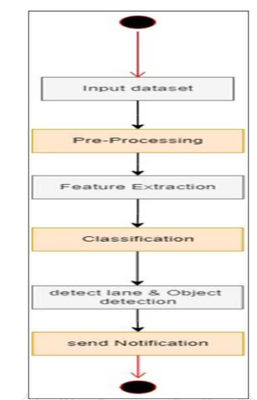
Active Diagrams

Slide 17
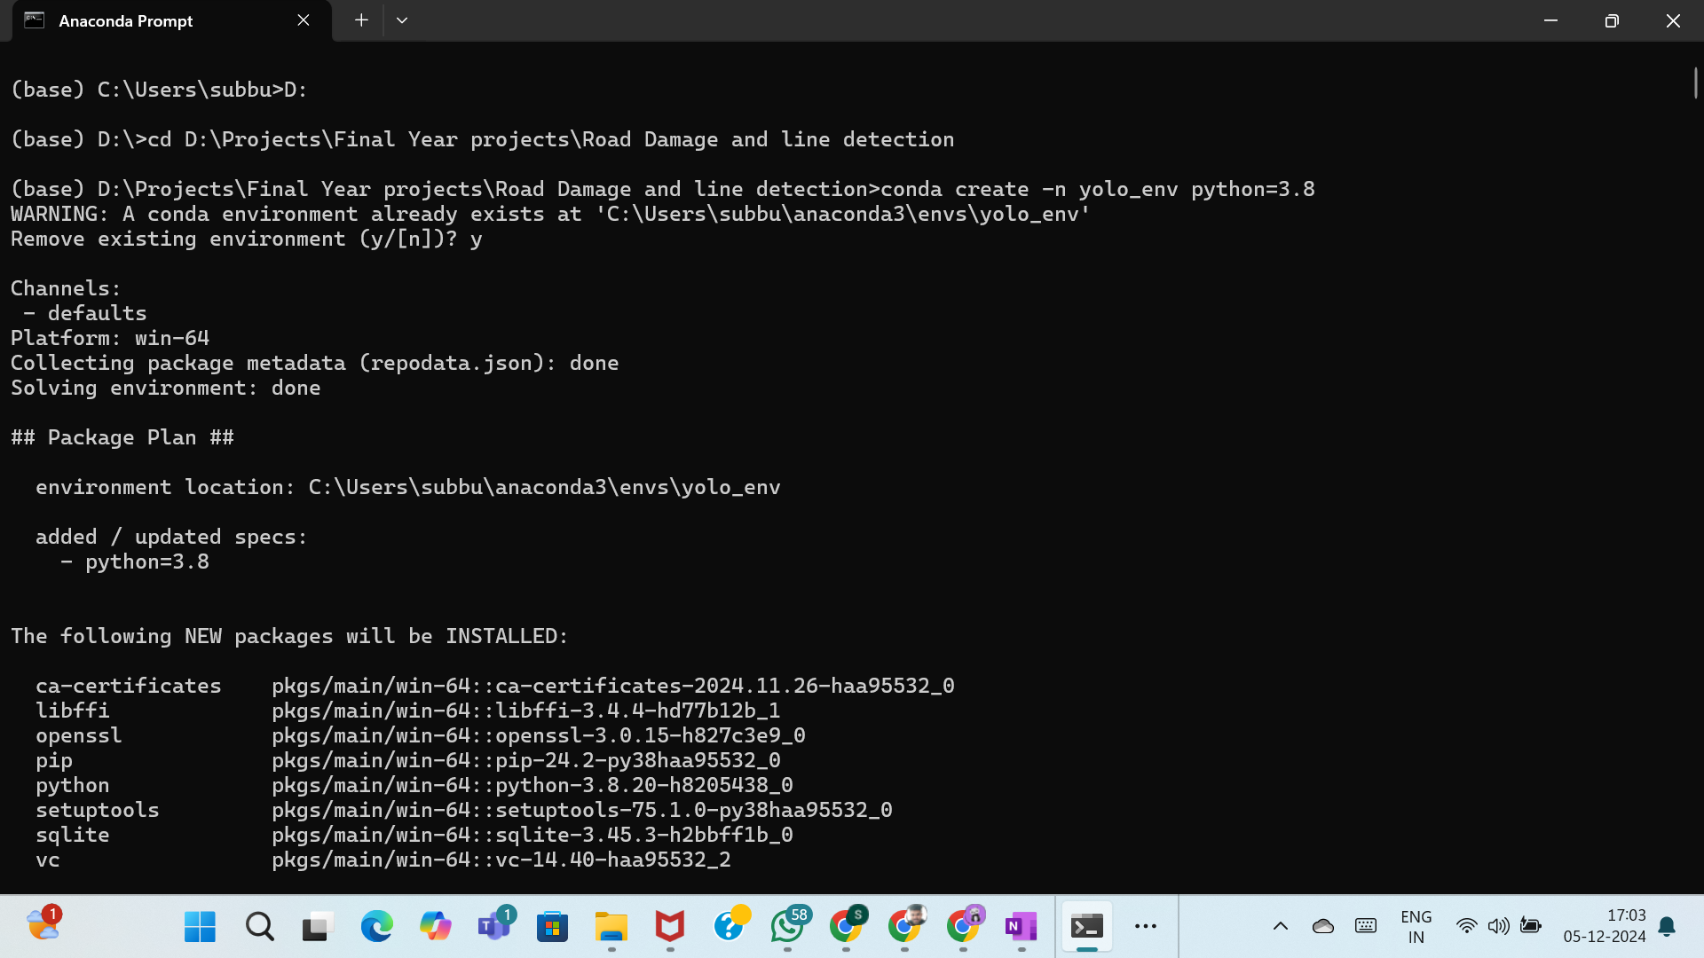
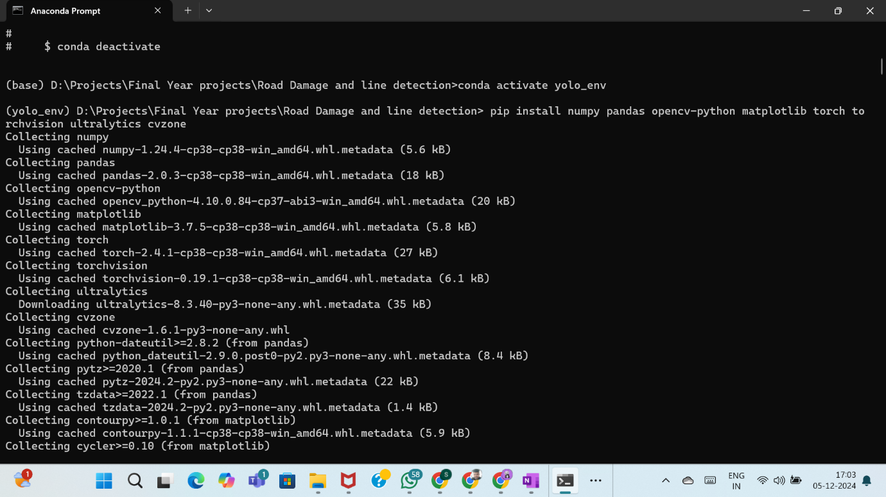
Final Output
The output of the proposed system provides real-time detection of road damage and lane markings using AI-based techniques. It identifies road defects like cracks and potholes while ensuring precise lane tracking for autonomous vehicles. The system improves roadway safety and assists vehicles in maintaining proper lane positioning and navigating obstacles effectively.

Slide 18
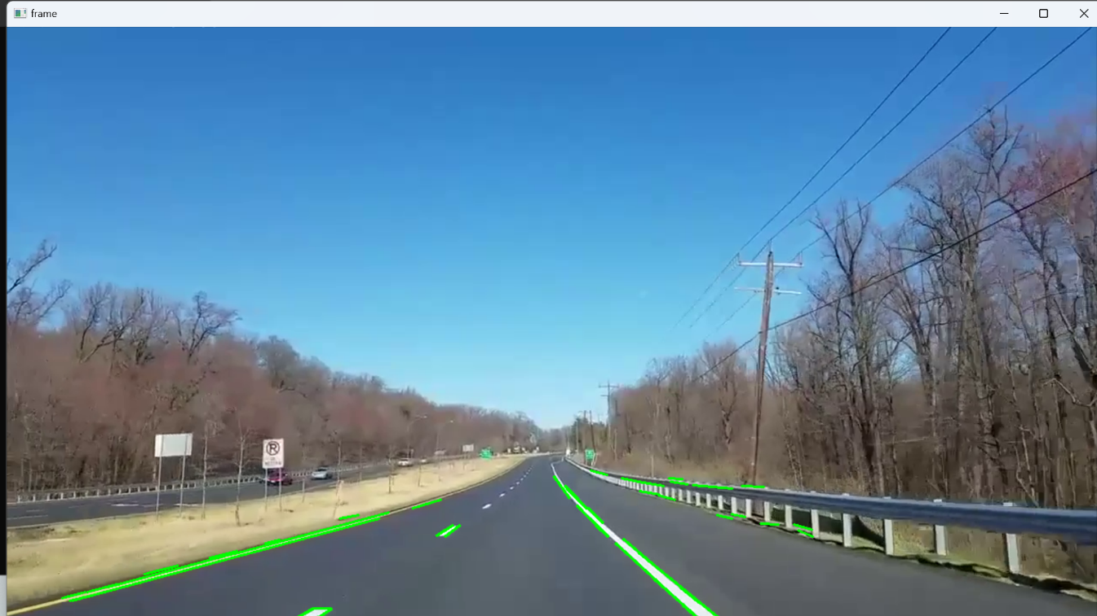
Final Output
Detect road lane

Slide 19
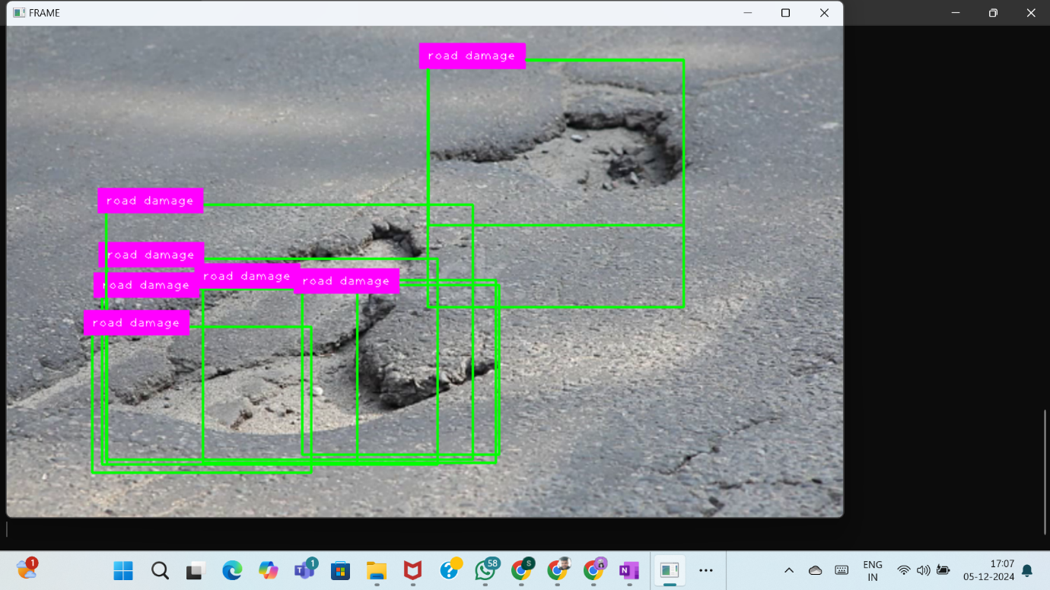
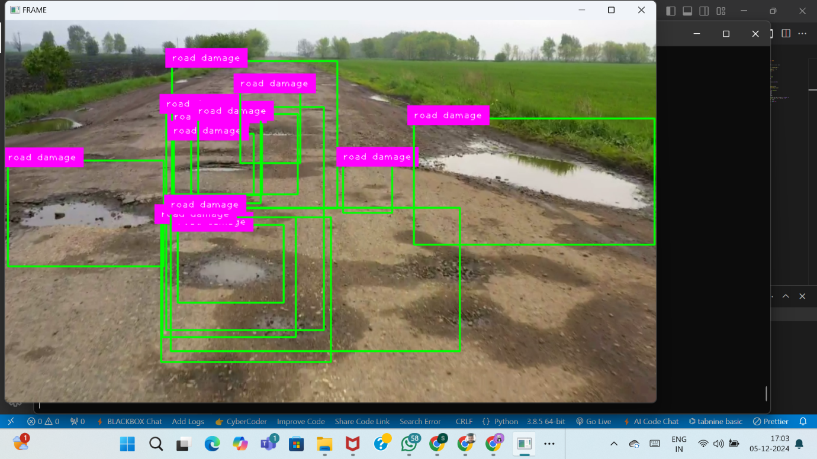
Final Output
Detect Damages On Road

Slide 20
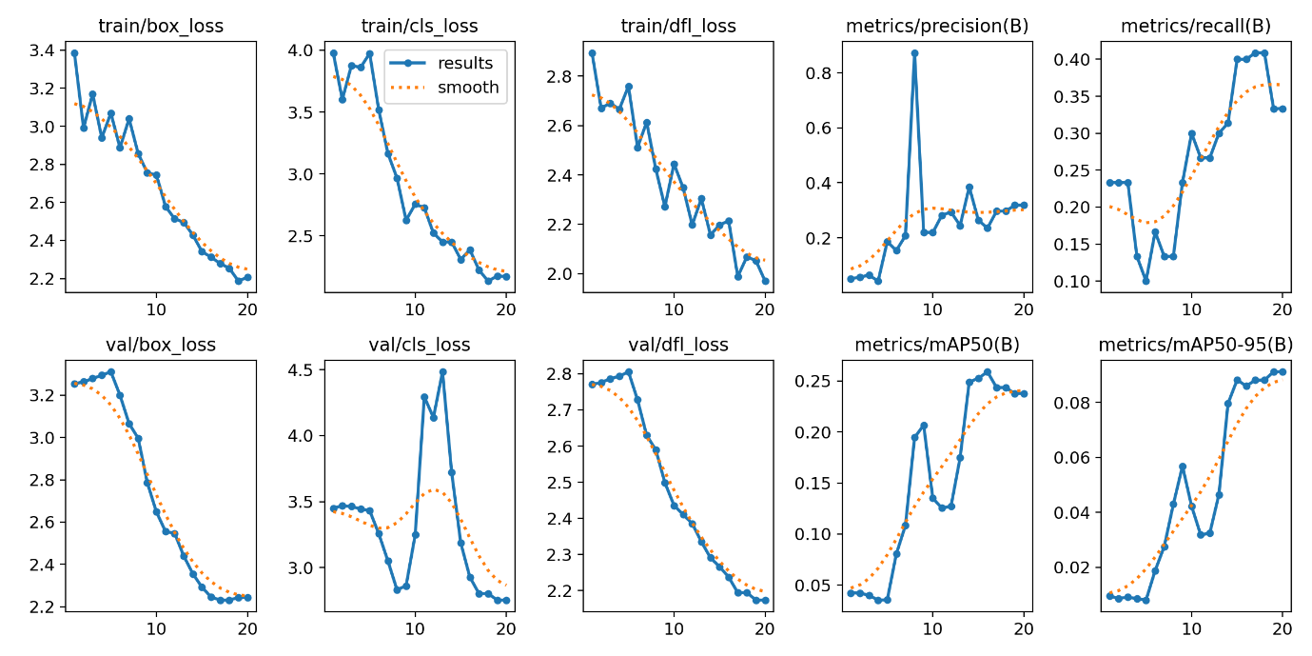
Final Output
YOLO Detected Analysis

Slide 21
Conclusion
In conclusion, the AI-powered road damage and lane detection system significantly enhances autonomous vehicle navigation by accurately identifying road hazards and lane markings in real-time. This technology not only improves safety but also contributes to more efficient transportation systems. The integration of YOLO and advanced image processing techniques provides a reliable solution for future roadway management and autonomous driving.

